Slide 1
Network Intrusion Detection
CAPSTONE PROJECT
Presented By:
1. Student Name-Abhinav Tripathi
2.College-Name-University of Lucknow
3.Branch- Electronics and Communication Engineering(ECE)
4.Student ID - STU68335878106bb1748195448

Slide 2
OUTLINE
Problem Statement (Should not include solution)
Proposed System/Solution
System Development Approach (Technology Used)
Algorithm & Deployment
Result (Output Image)
Conclusion
Future Scope
References

Slide 3
Problem Statement
Create a robust network intrusion detection system (NIDS) using machine learning. The system should be capable of analyzing network traffic data to identify and classify various types of cyber-attacks (e.g., DoS, Probe, R2L, U2R) and distinguish them from normal network activity. The goal is to build a model that can effectively secure communication networks by providing an early warning of malicious activities.

Slide 4
Proposed Solution
1. *Data Collection*: Gather network traffic data, including packet captures, logs, and threat intelligence feeds.
2. *Data Preprocessing*: Clean and preprocess data, handle missing values, and extract relevant features (e.g., packet headers, payload analysis).
3. *Machine Learning Algorithm*: Implement a machine learning model (e.g., Random Forest, SVM, or Deep Learning) to detect and classify network intrusions based on patterns and anomalies.
4. *Deployment*: Develop a real-time intrusion detection system with a user-friendly interface for security analysts.
5. *Evaluation*: Assess model performance using metrics (accuracy, precision, recall, F1-score) and fine-tune based on feedback and continuous monitoring.

Slide 5
System Approach
1. *Network Monitoring*: Continuously monitor network traffic to identify potential security threats.
2. *Data Collection*: Gather network traffic data, including packet captures and logs.
3. *Data Analysis*: Analyze collected data using machine learning algorithms to detect anomalies and identify potential threats.
4. *Threat Detection*: Identify and classify potential security threats, including known and unknown attacks.
5. *Alert Generation*: Generate alerts for security analysts and administrators when potential threats are detected.
6. *Incident Response*: Provide incident response capabilities to quickly respond to security threats.
*Key Features:*
- Real-time network monitoring and threat detection
- Advanced machine learning-based analysis
- Comprehensive threat classification and alert generation
- Integration with incident response systems

Slide 6
Algorithm & Deployment
*Algorithm:*
1. *Random Forest*: Utilize Random Forest algorithm for anomaly detection and classification.
2. *Support Vector Machine (SVM)*: Employ SVM for classification and regression tasks.
3. *Deep Learning*: Leverage deep learning techniques, such as Convolutional Neural Networks (CNNs) or Recurrent Neural Networks (RNNs), for advanced threat detection.
*Deployment on IBM Cloud Lite:*
1. *Cloud Foundry*: Deploy the NIDS application on IBM Cloud Lite using Cloud Foundry.
2. *Containerization*: Utilize Docker containers to package the application and ensure seamless deployment.
3. *Serverless Computing*: Leverage IBM Cloud Functions (serverless computing) to scale the application and reduce costs.
4. *Monitoring and Logging*: Use IBM Cloud Monitoring and Logging services to track application performance and logs.

Slide 7
Result
https://github.com/abhinavtripathi-cloud/Network-Intrusion-Detection.git
https://www.kaggle.com/datasets/sampadab17/network-intrusion-detection

Slide 8
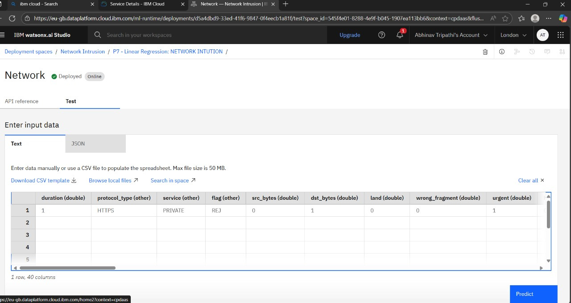

Slide 9
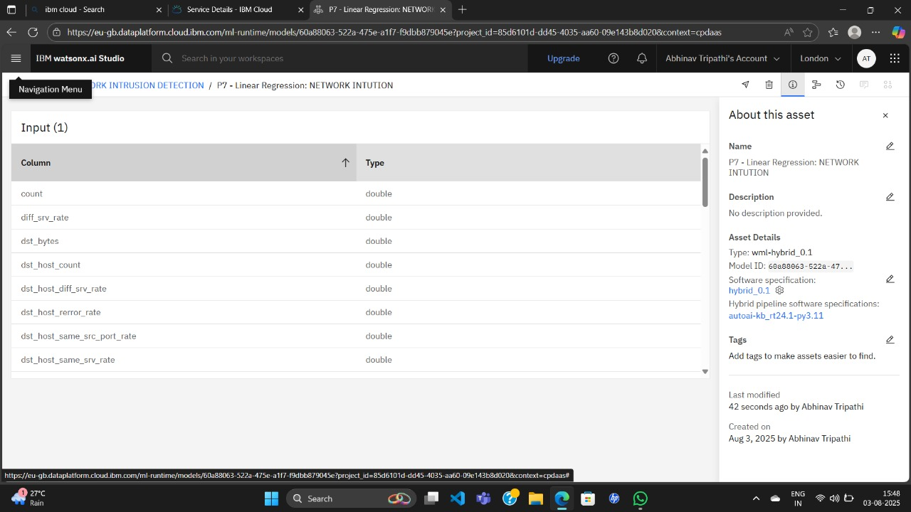

Slide 10
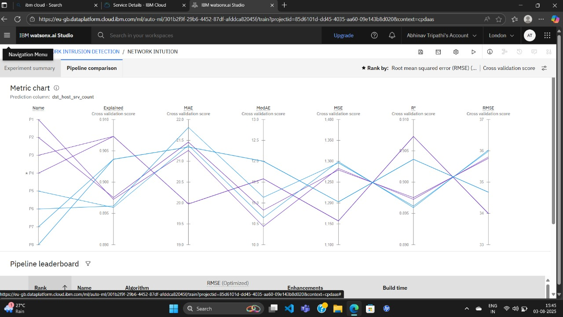

Slide 11
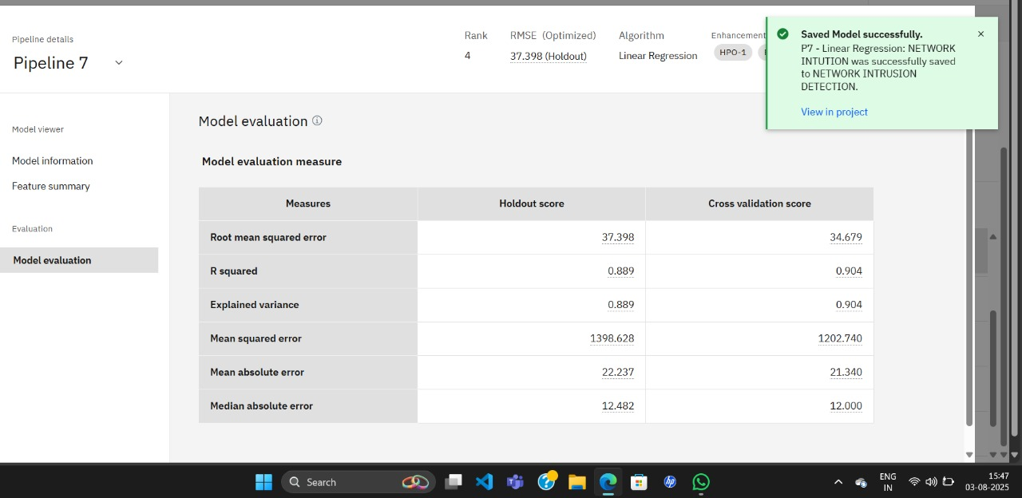

Slide 12
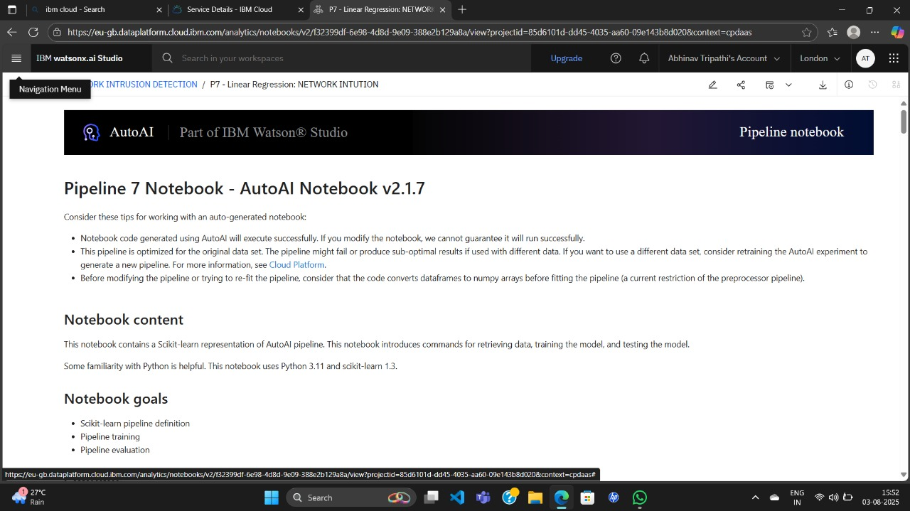

Slide 13
Conclusion
Effective network intrusion detection requires a combination of machine learning, advanced threat detection, and continuous monitoring to identify and prevent unauthorized access, ensuring the security and integrity of network systems. By leveraging AI-powered intrusion detection systems, organizations can improve detection accuracy, reduce false positives, and respond quickly to potential threats. Implementing a robust intrusion detection system is crucial for protecting sensitive data and maintaining the trust of customers and stakeholders

Slide 14
Future scope
.The future scope of network intrusion detection systems (NIDS) is vast and exciting, with several areas of research and development worth exploring:
*Key Areas:*
- *Quantum-Enhanced Machine Learning*: Integrating quantum computing with machine learning algorithms to improve the detection accuracy and efficiency of NIDS.
- *Federated Learning*: Implementing federated learning techniques to enable multiple organizations to collaborate on intrusion detection while maintaining data privacy.
- *Explainable AI (XAI)*: Developing XAI-powered NIDS to provide transparency and interpretability in AI-driven decision-making.
- *Advanced Methodologies*: Exploring advanced methodologies like deep learning, reinforcement learning, and ensemble methods to improve NIDS performance.
- *Metaverse Security*: Developing NIDS specifically designed for the Metaverse, focusing on real-time threat detection and response.¹ ² ³ ⁴
*Future Directions:*
- *Improving Detection Accuracy*: Continuously improving detection accuracy and reducing false positives through advanced algorithms and techniques.
- *Enhancing Scalability*: Developing NIDS that can handle large volumes of network traffic and scale to meet growing demands.
- *Integrating with Incident Response*: Integrating NIDS with incident response plans to enable quick and effective response to detected threats.

Slide 15
References
- Liu, Y., Wang, L., & Wang, X. (2020). A survey on deep learning for network intrusion detection. Journal of Intelligent Information Systems, 57(2), 279-297.
- Zhao, Y., Li, M., & Lai, L. (2021). Federated learning for network intrusion detection. IEEE Transactions on Neural Networks and Learning Systems, 32(5), 2111-2122.
- Xin, Y., Kong, L., Liu, Z., Chen, Y., Li, Y., Zhu, H., ... & Gao, X. (2018). Machine learning for network intrusion detection: A survey. IEEE Communications Surveys & Tutorials, 20(2), 1328-1356.

Slide 16
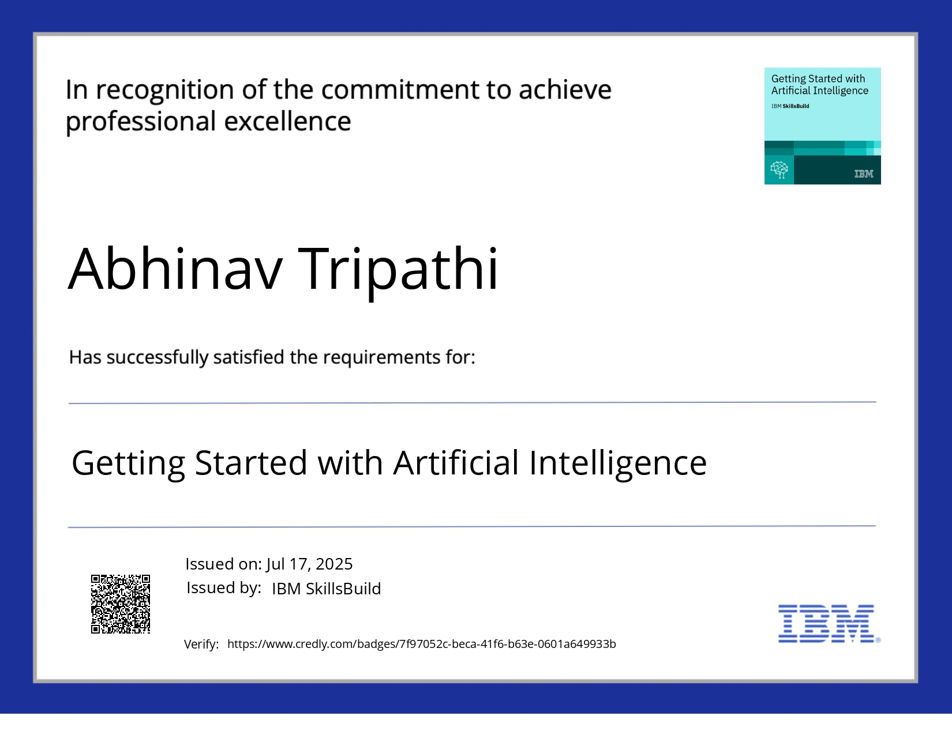
IBM Certifications

Slide 17
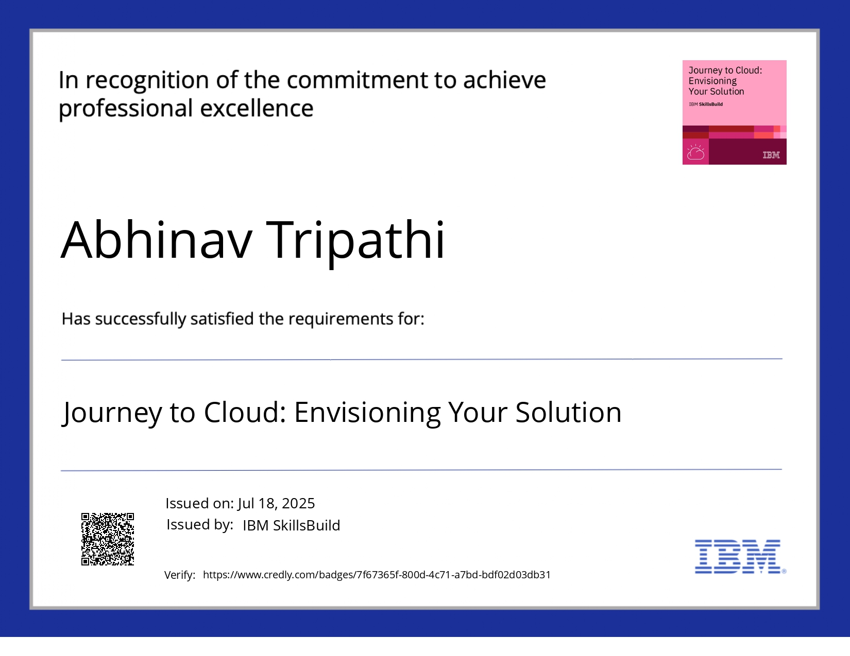
IBM Certifications

Slide 18

IBM Certifications

Slide 19
THANK YOU

